Slide 1




Adventure Globe
Gear Up for an Active Life, Anywhere on Earth
Performance Analysis
BY
Amir

Slide 2




About us
AdventureGlobe is a global e-commerce platform where people buy goods online. We offer a vast selection of products ranging from electronics, clothing, and home goods to books and toys, with a major focus on active lifestyles. Our specialized categories include sports, fitness, outdoor gear, and wellness items
We cater to consumers and businesses in regions including North America, Europe, Asia, Latin America, and Africa

Slide 3

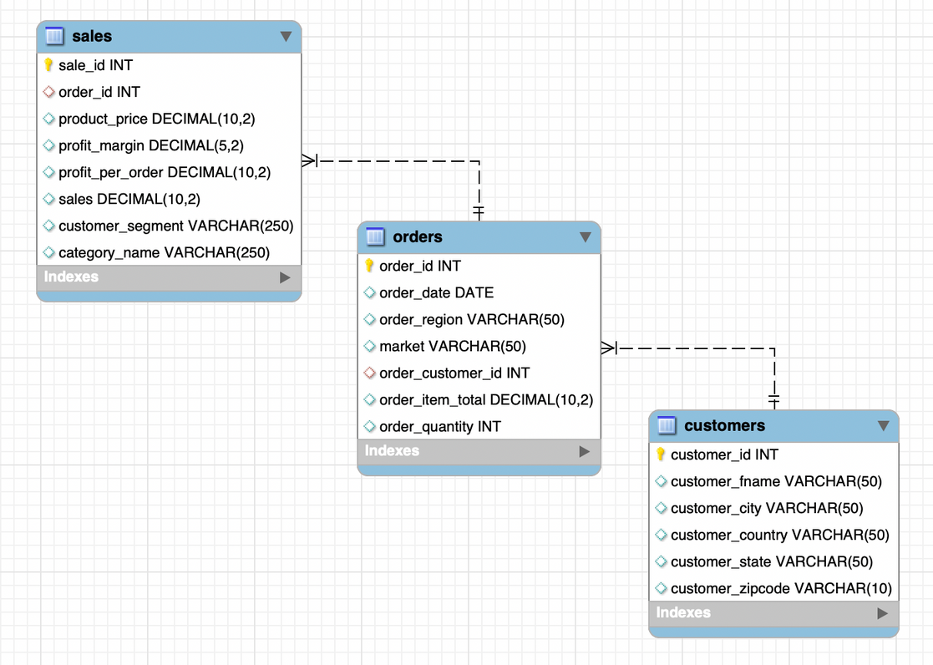




Database
The Database has three different tables with the respective information of customers, sales and orders. We joined these tables to create our database with the relevant information required for the analysis.
Sales
Orders
Customers
What are our revenue and profits
Which Market is performing best
Which products brings most value
What kind of customers are ordering from our portal
Hypothesis

Slide 4





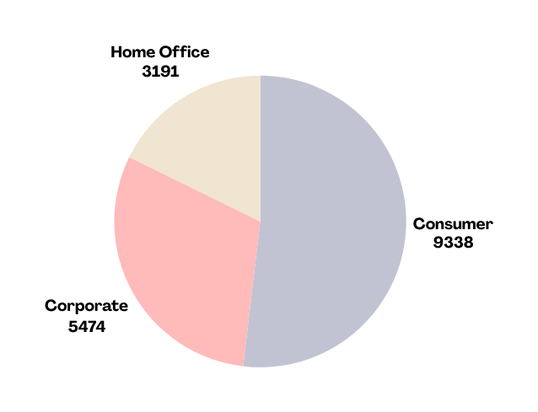
About Data
Dataset spans a period of 2 years
Total Orders:
42K+
Number of Customers:
18000
Average Purchase Value: $644
Total customer from each segmet:
Consumer: Individual buyers purchasing for personal use.
Corporate: Businesses making purchases for corporate needs.
Home Office: Customers operating from a home office setup.

Slide 5

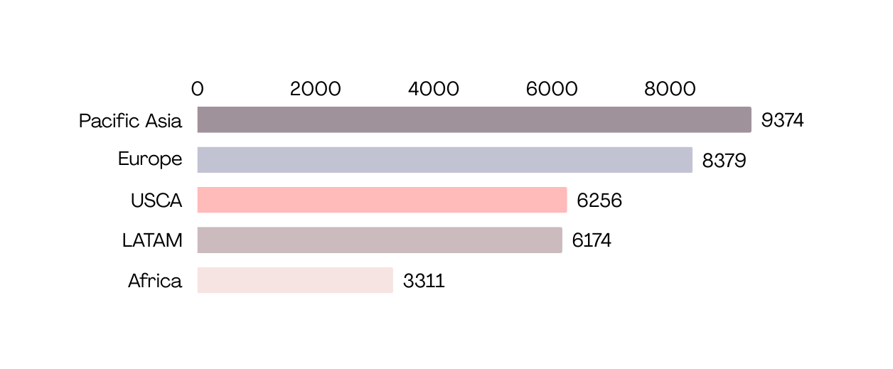


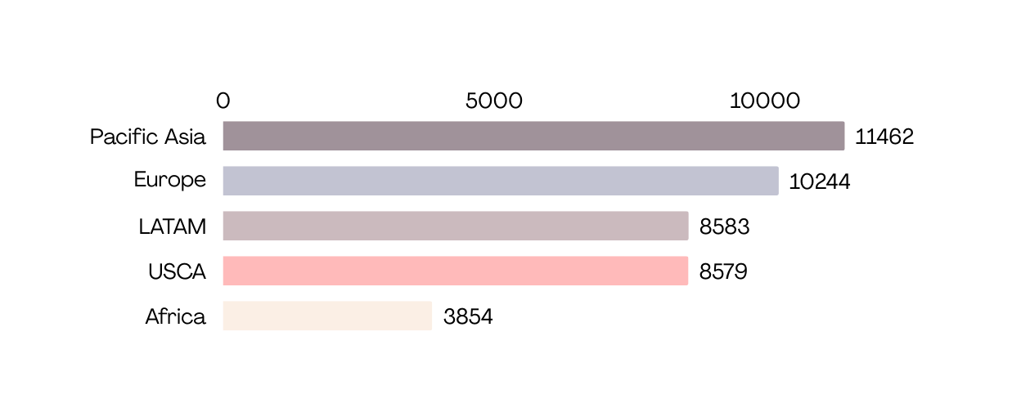

Total Customers by Market
Returning Customer
Rate
Market wise total number of customers
63%
Total Unique Orders by Market
Correlation Coefficient
Market wise total number of orders
0.83
Strong positive correlation between
total customers and total number of orders

Slide 6
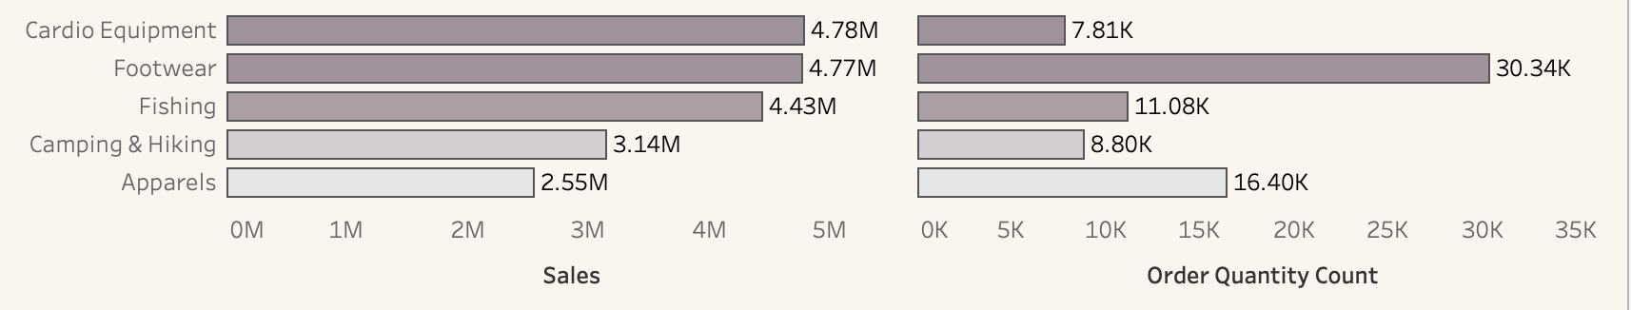
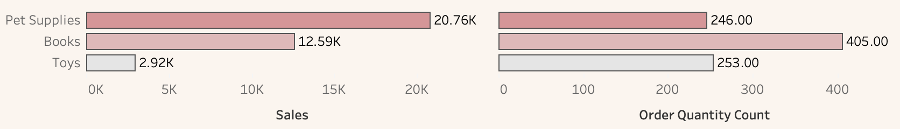
Top Selling Categories
Top categories in terms of sales and the respective revenue from each category
Lowest Selling Categories
Lowest categories in terms of sales and the respective revenue from each category

Slide 7

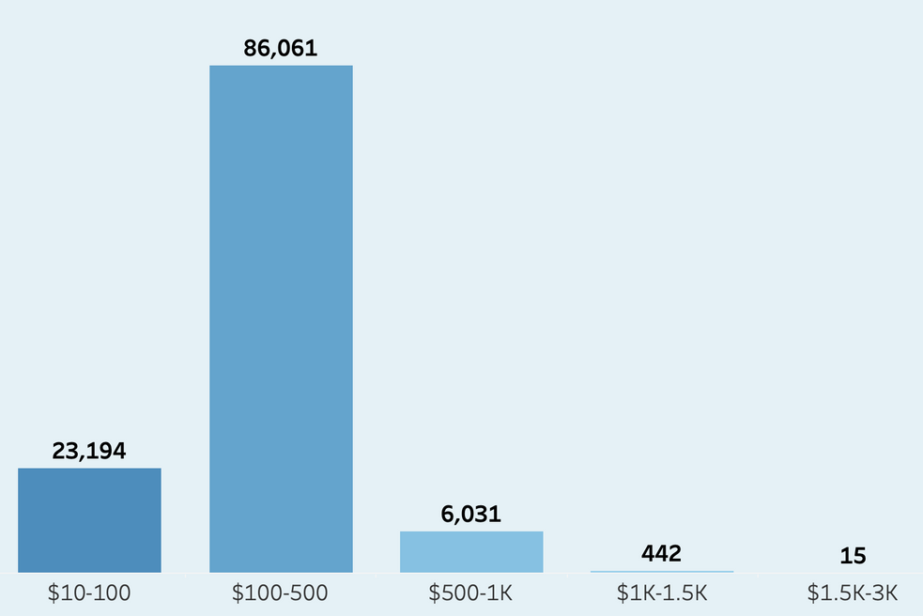
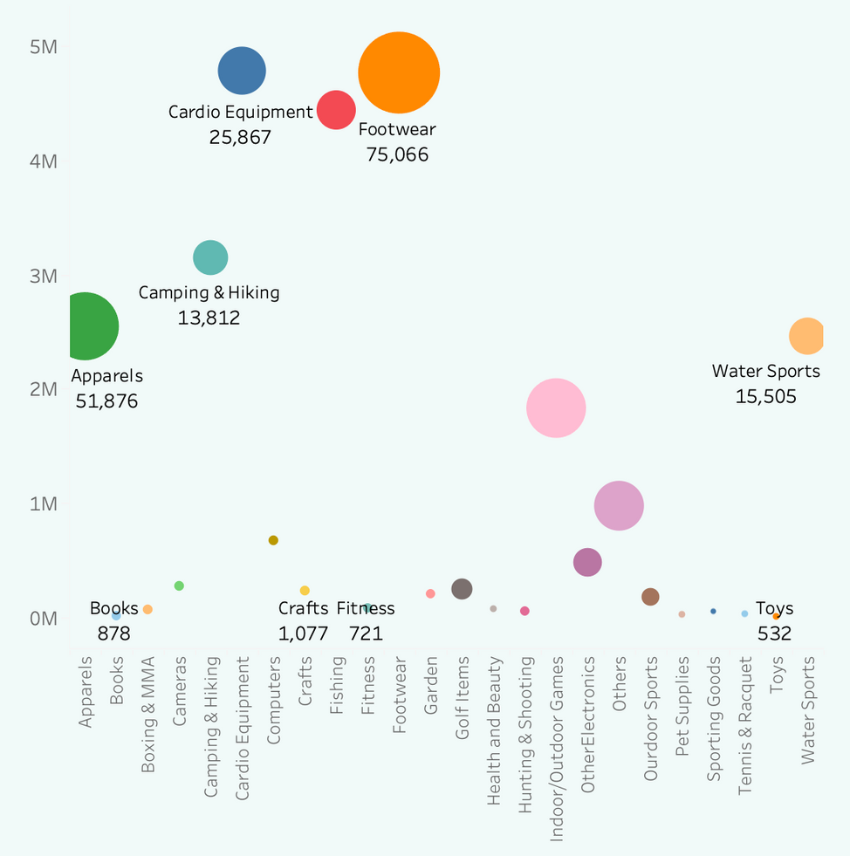

Sales count based on the Price
Order Vs Sales
Bulk of the sales come from lower-priced items, suggesting high demand for more affordable products
Significant drop for items selling above $500
Scatter Plot showing order quantity vs. sales for different categories.

Slide 8
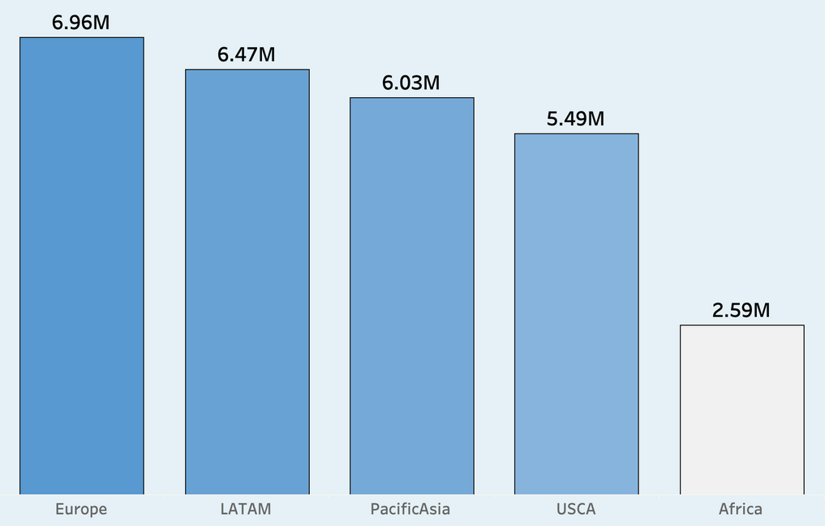

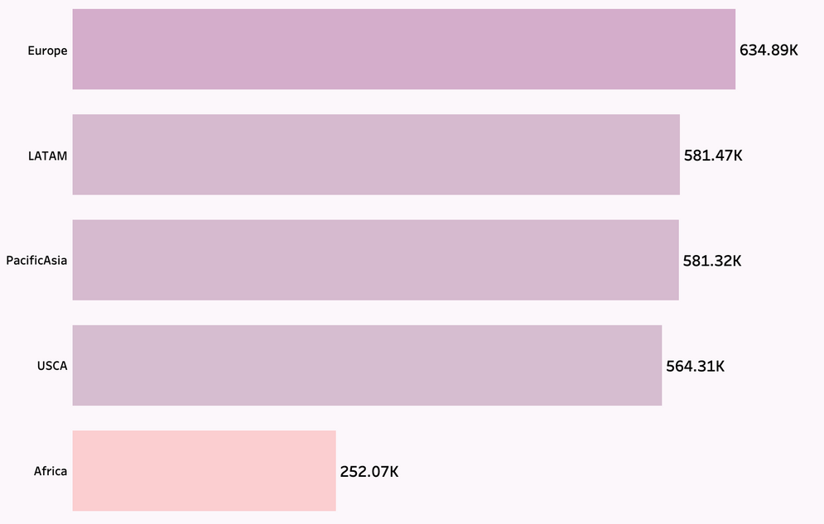

Total Sales By Market
Market wise total sales generated in the span of two years,
Total Revenue Generated
$27.54M
Profits By Market
Market wise total profit generated in the span of two years,
Total Profits Generated
Correlation Coefficient
$2.61M
0.10
Weak positive correlation
between sales and profit

Slide 9




Other Metrics
Profit Margin
Average Profit Per Order
Yearly Growth Percentage
9.5%
$22
5%
Tableau

Slide 10


Challenges
Annual growth rate is 5% which is considered modest in a fast-moving e-commerce market.
A profit margin of 9% suggests there is limited room for profit per transaction. If costs increase, this margin could become tighter.
The business is relying too heavily on existing customers which is 63%, business could face stagnation
Average Purchase Value of $644 indicate reliance on high-value purchases, as major customers falls in $500 bucket
Opportunities
High repeat purchase rate indicates strong foundation of loyal customers
The business already has a high Average Purchase Value $644 indicating customers are willing to spend on our portal
Low sales during November and December presents an opportunity to enhance revenue by promoting winter activity items and Christmas festivity products

Slide 11


Recommendations
Implement loyalty programs, subscription models, and personalised marketing for repeat customers.
The profit margin is currently at 9%, which indicates room for improvement, renegotiating supplier contracts, optimising logistics, or reducing operational inefficiencies may improve margins.
Average purchase frequency rate of 2.37, consider investing in customer acquisition strategies like target advertising and influencer partnerships.
With yearly growth rate of 5%, We can consider expanding into new markets or regions to drive faster growth.
Introduce sustainable operational improvements that emphasises sustainability to attract new customers

Slide 12




BY
Amir

